Slide 1
Disorders of Respiratory System
Pathophysiology
Lecture 1
د. تماضر حامد وادي
فرع العلوم المختبرية السريرية

Slide 2
Disorders associated with pulmonary diseases

Slide 3
Pneumonia
Pneumonia can be very broadly defined as any infection in the lung.
The histologic spectrum of pneumonia may range from a fibrinopurulent alveolar exudate seen in acute bacterial pneumonias, to mononuclear interstitial infiltrates in viral and other atypical pneumonias, to granulomas and cavitation seen in many of the chronic pneumonias.
Acute bacterial pneumonias can manifest as one of two anatomic and radiographic patterns, referred to as bronchopneumonia and lobar pneumonia.
Streptococcus pneumoniae (the pneumococcus) is responsible for more than 90% of lobar pneumonias.

Slide 4
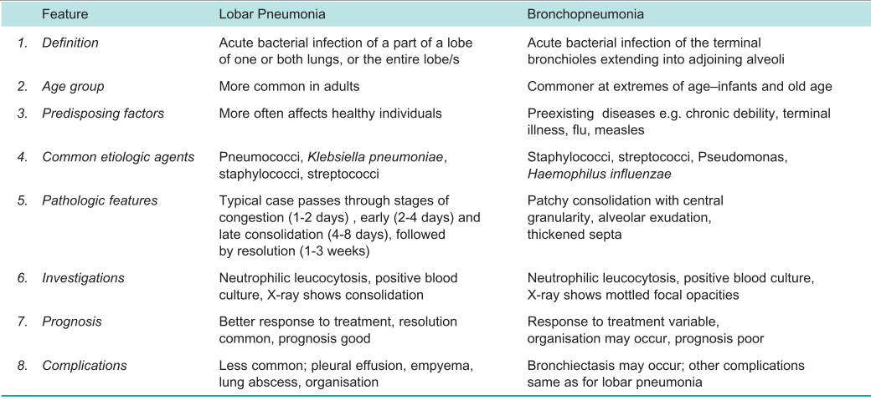
Contrasting Features of Lobar Pneumonia and Bronchopneumonia

Slide 5
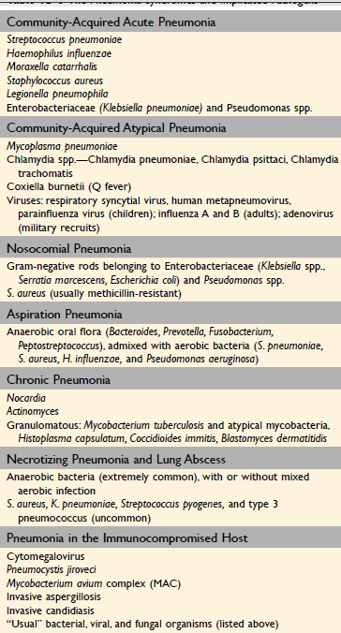
The Pneumonia Syndromes and Implicated Pathogens

Slide 6
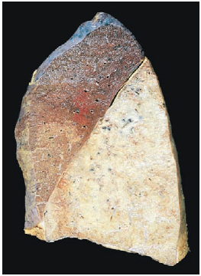
Features of Pneumonia
Before antibiotics, pneumococcal pneumonia involved entire or almost entire lobes and evolved through four stages:
congestion
red hepatization,
gray hepatization
resolution.
Gross view of lobar pneumonia with gray hepatization.

Slide 7
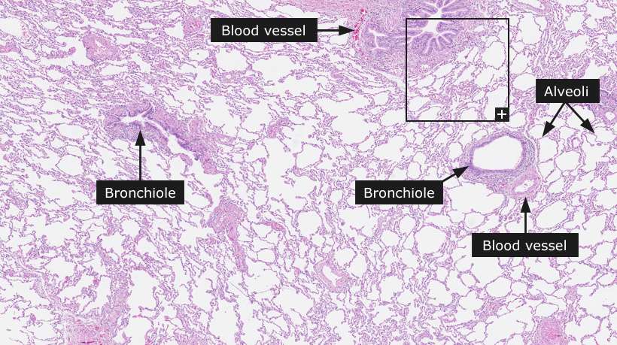
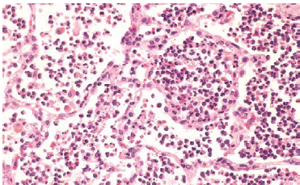
Features of Pneumonia
Normal lung
During the first stage, that of congestion, the affected lobe(s) is (are) heavy, red, and boggy; histologically, vascular congestion can be seen, with proteinaceous fluid, scattered neutrophils, and many bacteria in the alveoli. Within a few days, the stage of red hepatization ensues, in which the lung lobe has a liver-like consistency; the alveolar spaces are packed with neutrophils, red cells, and fibrin. In the next stage, gray hepatization, the lung is dry, gray, and firm, because the red cells are lysed, while the fibrinosuppurative exudate persists within the alveoli. Resolution follows in uncomplicated cases, as exudates within the alveoli are enzymatically digested to produce granular, semifluid debris that is resorbed, ingested by macrophages, coughed up, or organized by fibroblasts growing into it.
Acute pneumonia. The congested septal capillaries and extensive neutrophil exudation into alveoli correspond to early red hepatization. Fibrin nets have not yet formed.

Slide 8
Tuberculosis
Tuberculosis is a communicable chronic granulomatous disease caused by Mycobacterium tuberculosis, usually affecting the lungs, but virtually any extrapulmonary organ can be involved in isolated infection.
Infection with M. tuberculosis typically leads to the development of delayed hypersensitivity, which can be detected by the tuberculin (Mantoux) test.
The pathogenesis of tuberculosis in the previously unexposed immunocompetent person is centered on the development of a targeted cell-mediated immunity that confers resistance to the organism and results in development of tissue hypersensitivity to tubercular antigens. The pathologic features of tuberculosis, such as caseating granulomas and cavitation, are the result of the destructive tissue hypersensitivity that is part and parcel of the host immune response.

Slide 9
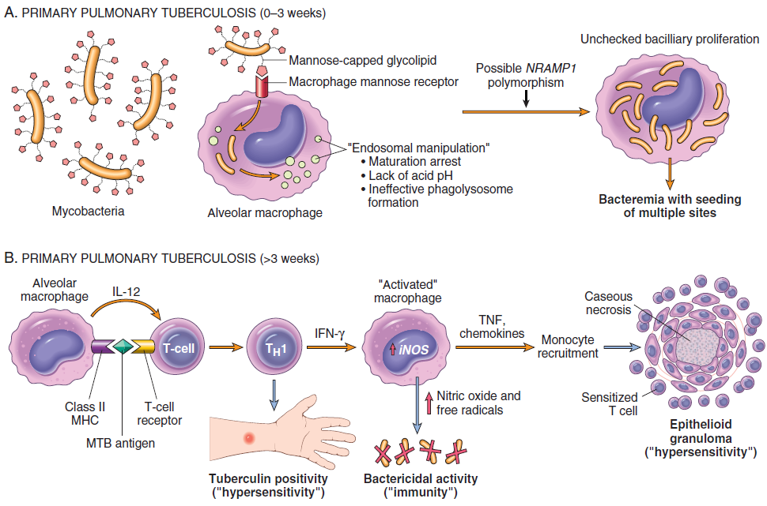
Pathogenesis of Tuberculosis

Slide 10
Pathogenesis of Tuberculosis
Once a virulent strain of mycobacteria gains entry into the macrophage endosomes (a process mediated by several macrophage receptors, including the macrophage mannose receptor and complement receptors that recognize several components of the mycobacterial cell walls), the organisms are able to inhibit normal microbicidal responses by preventing the fusion of the lysosomes with the phagocytic vacuole. The prevention of phagolysosome formation allows unchecked mycobacterial proliferation. Thus, the earliest phase of primary tuberculosis (in the first 3 weeks) in the nonsensitized patient is characterized by bacillary proliferation within the pulmonary alveolar macrophages and air spaces, with resulting bacteremia and seeding of multiple sites. Despite the bacteremia, most persons at this stage are asymptomatic or have a mild flu-like illness.
The development of cell-mediated immunity occurs approximately 3 weeks after exposure. Processed mycobacterial antigens reach the draining lymph nodes and are presented to CD4 T cells by dendritic cells and macrophages. Under the influence of macrophage-secreted IL-12, CD4+ T cells of the TH1 subset are generated that are capable of secreting IFN-γ. The development of resistance to the organism is accompanied by conversion to a positive result on tuberculin skin testing.

Slide 11
Pathogenesis of Tuberculosis
IFN-γ released by the CD4+ T cells of the TH1 subset is crucial in activating macrophages. Activated macrophages, in turn, release a variety of mediators and upregulate expression of genes with important downstream effects, including (1) TNF, which is responsible for recruitment of monocytes, which in turn undergo activation and differentiation into the “epithelioid histiocytes” that characterize the granulomatous response; (2) expression of the inducible nitric oxide synthase (iNOS) gene, which results in elevated nitric oxide levels at the site of infection, with excellent antibacterial activity; and (3) generation of reactive oxygen species, which can have antibacterial activity. Nitric oxide is a powerful oxidizing agent that results in generation of reactive nitrogen intermediates and other free radicals capable of oxidative destruction of several mycobacterial constituents, from cell wall to DNA.
Defects in any of the steps of a TH1 response (including IL-12, IFN-γ, TNF, or nitric oxide production) result in poorly formed granulomas, absence of resistance, and disease progression. Persons with inherited mutations in any component of the TH1 pathway are extremely susceptible to infections with mycobacteria.

Slide 12
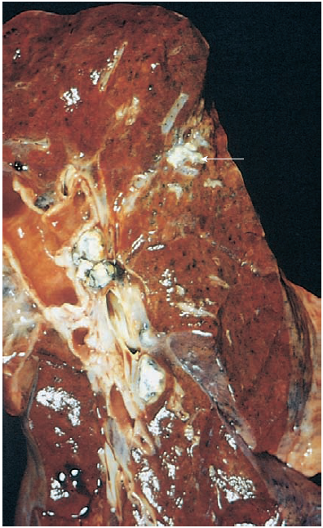
Features of Tuberculosis
Typically, the inhaled bacilli implant in the distal air spaces of the lower part of the upper lobe or the upper part of the lower lobe, usually close to the pleura. As sensitization develops, a 1- to 1.5-cm area of gray-white inflammatory consolidation emerges, the Ghon focus. In most cases the center of this focus undergoes caseous necrosis. Tubercle bacilli, either free or within phagocytes, travel in lymph drainage to the regional nodes, which also often caseate. This combination of parenchymal lesion and nodal involvement is referred to as the Ghon complex. During the first few weeks, there is also lymphatic and hematogenous dissemination to other parts of the body. In approximately 95% of cases, development of cell mediated immunity controls the infection. Hence, the Ghon complex undergoes progressive fibrosis, often followed by radiologically detectable calcification (Ranke complex), and despite seeding of other organs, no lesions develop.
On histologic examination, sites of active involvement are marked by a characteristic granulomatous inflammatory reaction that forms both caseating and noncaseating granulomas, which consist of epithelioid histiocytes and multinucleate giant cells.
Primary pulmonary tuberculosis, Ghon complex. The gray-white parenchymal focus (arrow) is under the pleura in the lower part of the upper lobe.

